Slide 1


Slide 2
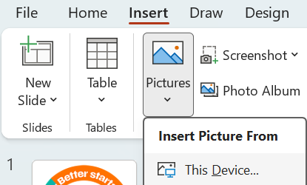
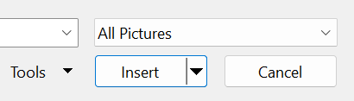
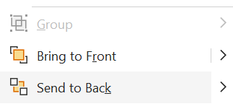
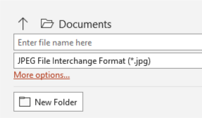
Steps to add BSU Frame to your profile image
1. | On the first slide, add your profile image by clicking on the menu bar “Insert Picture from This Device”
2. | Select the image of your choice from your file and click “Insert”
3. | Right click on your picture & click on “Send to Back”
4. | Adjust the size of the image to fit within the frame
5. | To save the image, click on “File”, “Save As” and ensure that the file format to “JPEG File Interchange Format (*.jpg)”, click on “Save” and “Just This One” to save a Jpeg version of your image to your selected folder.

